Slide 1


Book Recommendation System

Slide 2





Our Team
Youssef Maged
Maryam Ebrahim
Sara Hesham
Mohamed Nagi
Moaaz Ismail
Nour Elmergawy
Ahmed Essam
Amr Ashraf

Slide 3
TABLE OF CONTENTS
1.
2.
3.
Introduction
Requirement Analysis
Designing
4.
5.
6.
Project Aspects
Implementation
Testing
7.
8.
Security
Conclusion and Future work

Slide 4
1
Introduction

Slide 5

OUR PROJECT
Our graduation project is a Book Recommendation system, that recommend books for the users by Unsupervised ML model (Collaborative Filtering)
-User-Based
-Item-Based

Slide 6

Introduction
In the digital age, readers have access to a vast collection of books across different genres and formats. However, this abundance can make it difficult for readers to find books that match their preferences. Additionally, authors and publishers face stiff competition to grab readers' attention. To overcome these challenges, effective book promotion and discovery tools are essential.

Slide 7
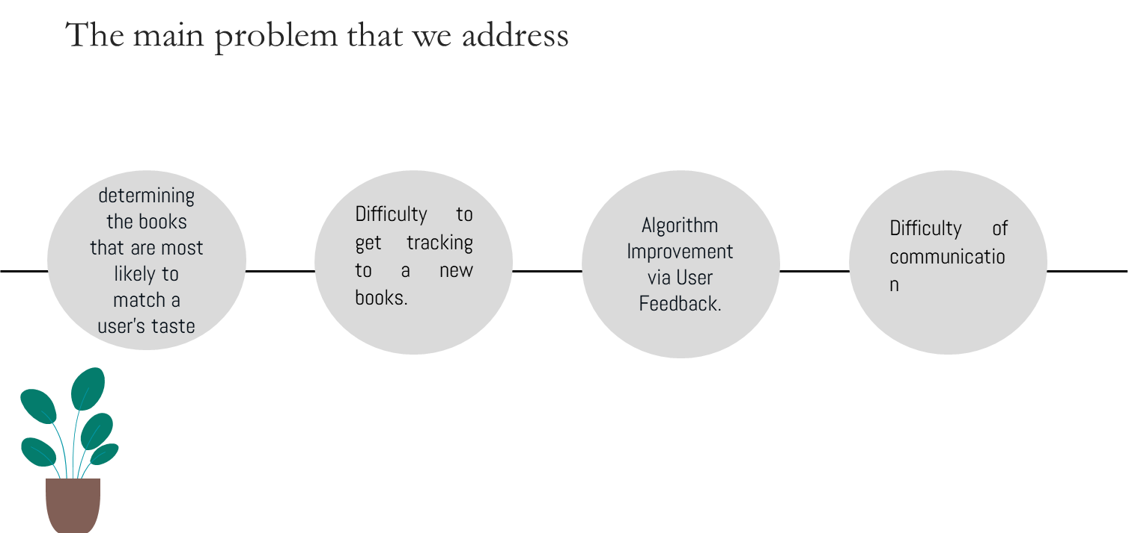
-Egypt literacy rate for 2017 was 71.17%, a 1.27% decline from 2013.

Slide 8
Benefits of the project
The app offers convenient user management, personalized book preferences, enhanced book interactions, seamless book purchasing, user ratings and reviews, comprehensive book search, personalized recommendations, discovery of similar books, and online book list and accessibility. It allows users to easily access saved preferences and book lists, making informed decisions and fostering community engagement. The app also allows users to discover similar books and save their lists for easy access from any internet-connected device.

Slide 9



FEATURES OF OUR PROJECT
Book recommendations
Lists
Search
Users get book recommendations based on their interactions
Users have their own lists favorite, wishlist and already-read
Users can search for a specific book from our database

Slide 10



FEATURES OF OUR PROJECT
Book Details
Similar Books
buy
Users can view the details of each book
Users are able to find similar books like the current viewed book
Users can buy their wanted books

Slide 11
2
Requirement Analysis

Slide 12
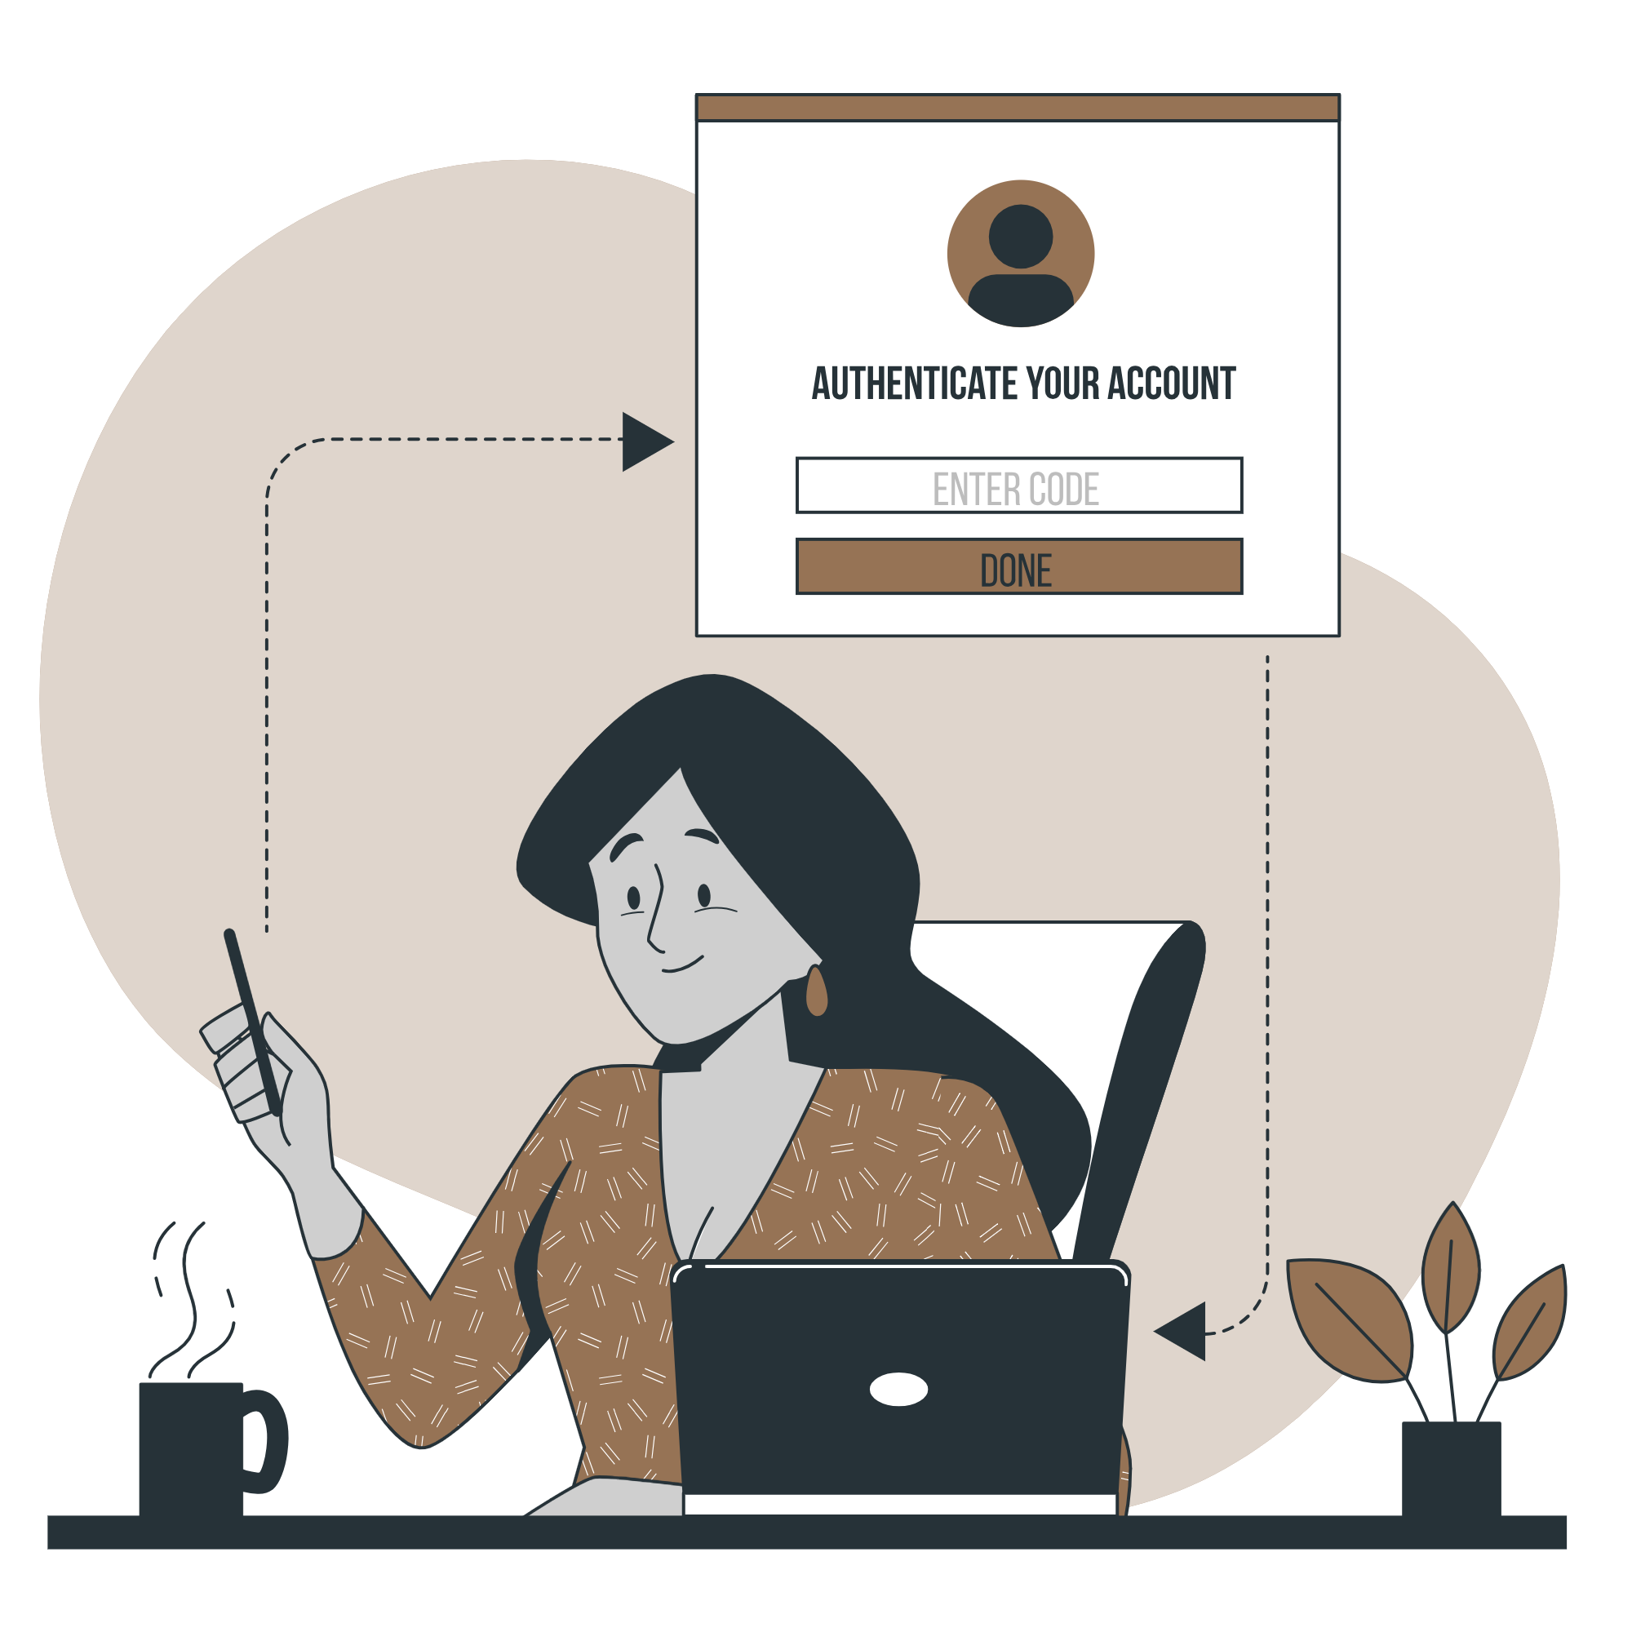
Functional Requirements
User
•logging in/out the system
•can see all books
•can like a book
•can view author page
•view profile
•can choose all favorite books categories
•evaluate books
•answer survey
•search for books
•buy books from online store
•view book page
•add to wishlist

Slide 13

Functional Requirements
Author
•logging in/out the system
•can add books

Slide 14

Functional Requirements
Admin
•logging in/out the system
•control the whole system
•can delete and insert books
•maintain the system
•manage the user inside the system
•accept registration

Slide 15

Non Functional Requirements
Security
Easy to handle
Performance
Storage
Legal

Slide 16
3
Designing

Slide 17
Data Flow Diagram
Context DFD

Slide 18
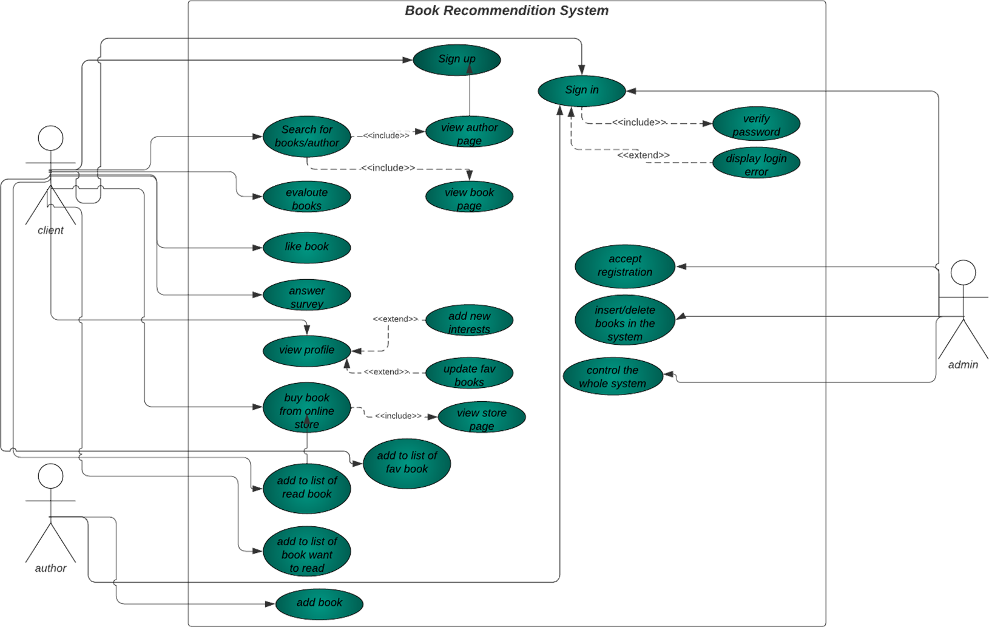
Unified Modeling Language(UML) Diagrams
Use Case Diagram

Slide 19
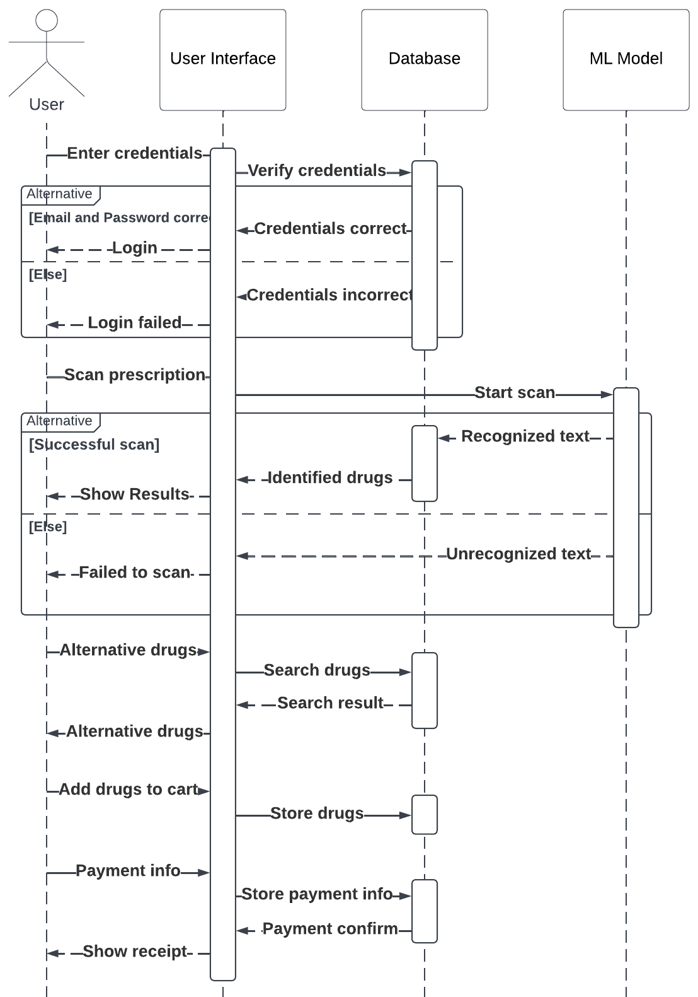
Sequence Diagram

Slide 20
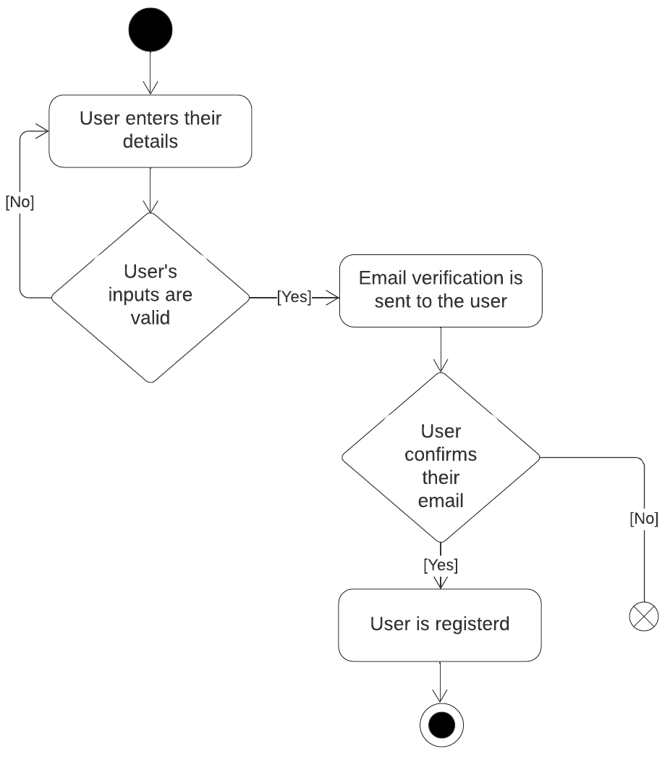
Activity Diagrams
Register

Slide 21
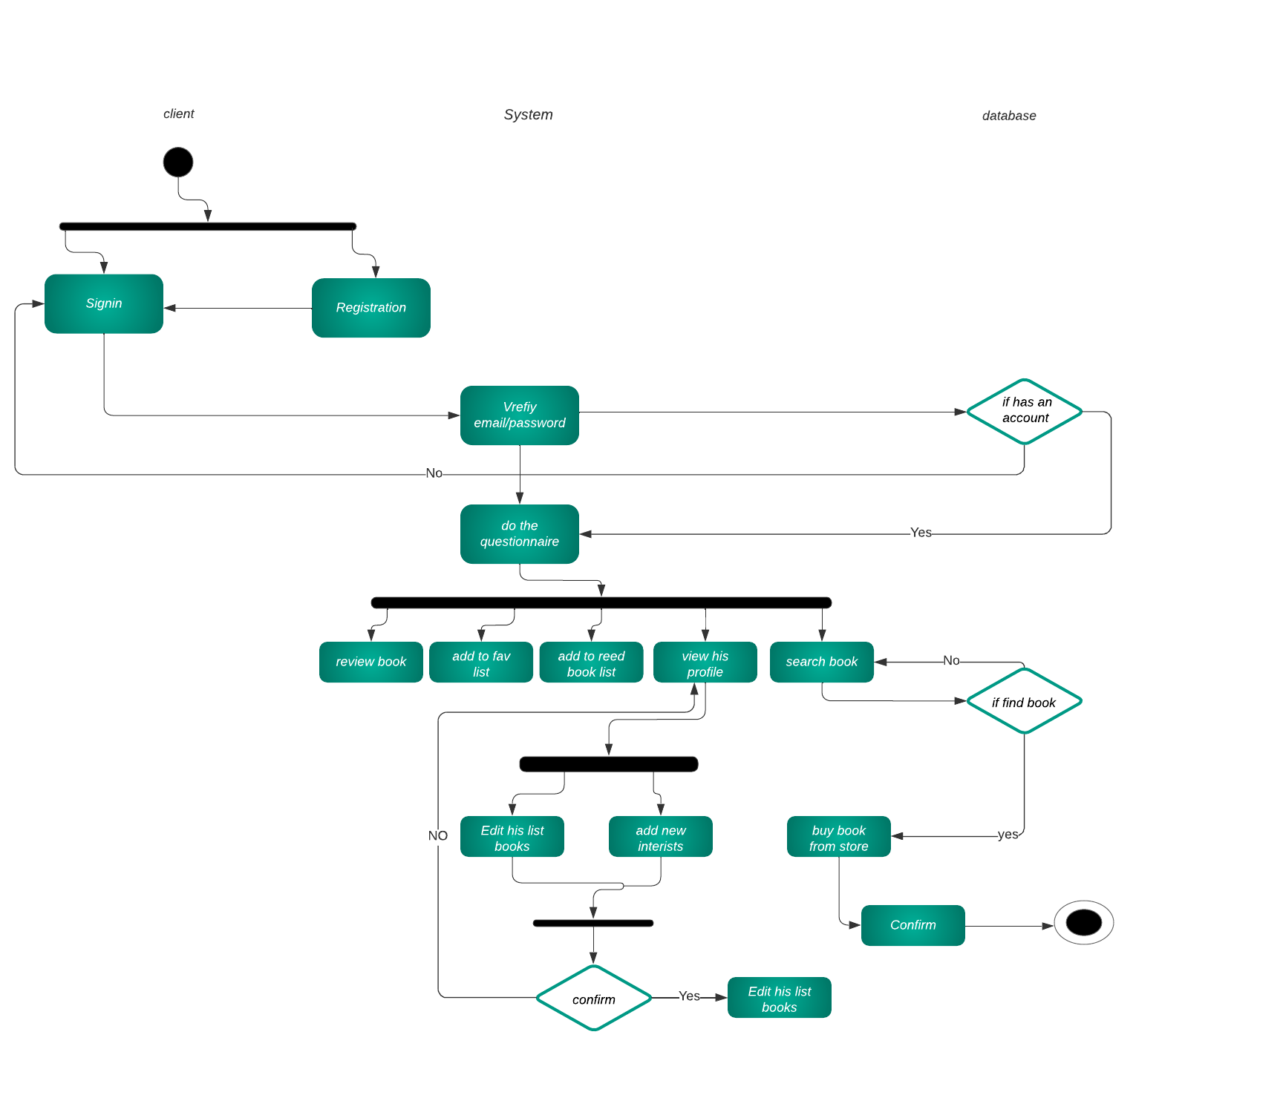

Slide 22
4
Project Aspects

Slide 23
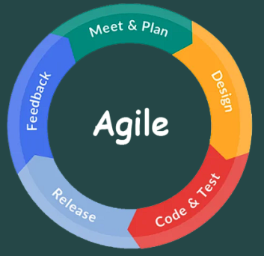
Developing Methodology
Agile Methodology which states that the phases are organized in an iterative and incremental cycles. Agile enables iterative, feedback-centric, and adaptable software development, promoting collaboration, continuous learning, and frequent delivery of value.
By adopting Agile, our development plan will be flexible and open to any changes and will also give us opportunities to check for mistakes or find bugs.

Slide 24
USED SOFTWARE
Node.js
Our backend environment with addition to Express.js framework
Flask
Our back-end environment for ML Model
Android
Our front-end SDK for the android application
MongoDB
Our NoSQL database of choice
Scikit-learn
Mongoose
Our ML framework for the AI model
our Object-Document Mapping library for Node.js and MongoDB
GitHub
Our collaboration and versions control tool

Slide 25
PROJECT COMPONENTS
The android application is the main access point to our project where users have access to all of the features we provide, including:book recommendations, searching for books and their alternatives and buying books
Android Application

Slide 26
PROJECT COMPONENTS
ML Model
Dataset
Unsupervised ML Technology:
User-based CF
Item-based CF
Making Prediction on New Data

Slide 27
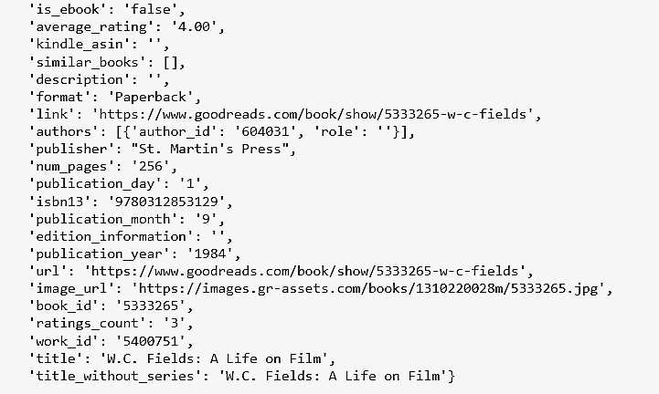
PROJECT COMPONENTS
ML Model
Dataset
This dataset contains ratings for ten thousand popular books. As to the source, let's say that these ratings were found on the internet. Generally, there are
Both book IDs and user IDs are contiguous. For books, they are 1-10000, for users , All users have made at least two ratings. and 13 million interactions for all users

Slide 28
PROJECT COMPONENTS
ML Model
User-based (Collaborative Filtering)
User-Based Collaborative Filtering (UBCF) is a technique commonly employed in recommendation systems. It aims to provide personalized recommendations to users based on their similarities with other users. UBCF utilizes a collaborative approach by leveraging the preferences and behaviors of similar users to make suggestions. By analyzing the historical data of user interactions, UBCF identifies patterns and relationships to predict a user's interests and preferences accurately.

Slide 29
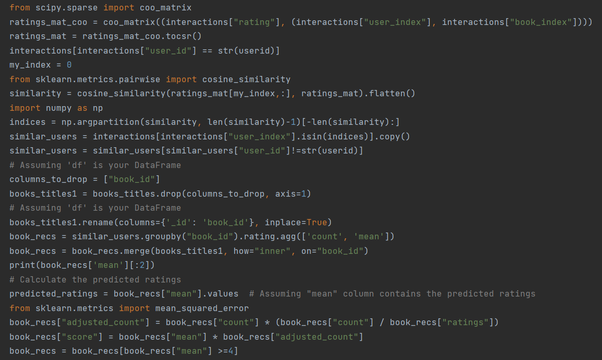

Slide 30
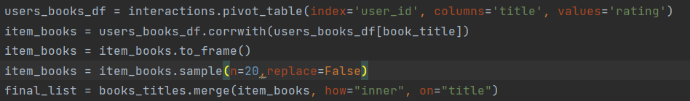
PROJECT COMPONENTS
ML Model
Item-based (Collaborative Filtering)
Item-Based Collaborative Filtering (IBCF) is a technique widely employed in recommendation systems. It aims to provide personalized recommendations to users based on the similarities between items in the system. IBCF leverages the historical data of user-item interactions to identify patterns and relationships between items. By analyzing the preferences and behaviors of users who have interacted with similar items, IBCF can predict a user's interests and preferences accurately. This approach enhances the recommendation process by suggesting items that are similar to those a user has previously engaged with, leading to a more tailored and satisfying user experience.

Slide 31
PROJECT COMPONENTS
ML Model
Making Prediction on New Data:
Making predictions on new data using a Collaborative filtering machine learning model involves applying the model to the new data to generate a prediction of output. The general process of making predictions are: preprocessing of the new data, loading the model with the data using python libraries , formatting the input, prediction generation, output interpretation and postprocessing.

Slide 32
PROJECT COMPONENTS
Book Database
By web scraping various sources we managed to collect more than
50,000 Books

Slide 33
5
Implementation

Slide 34
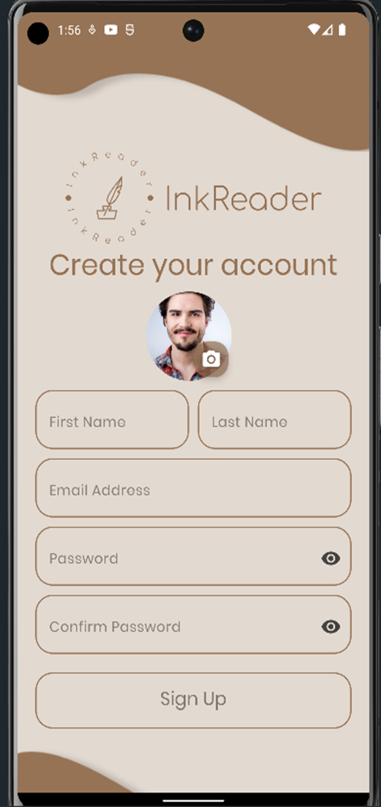
Mobile Application
Sign UP page where users fill their information to register on the application

Slide 35
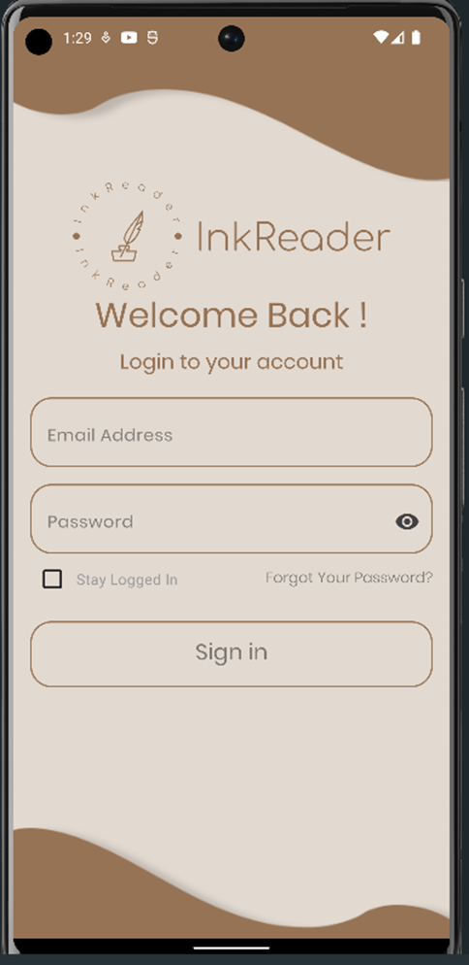
Mobile Application
Login page where users enter their email and password to gain access to the application

Slide 36
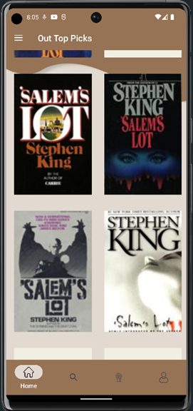
Mobile Application
The Home page where users can find all books

Slide 37
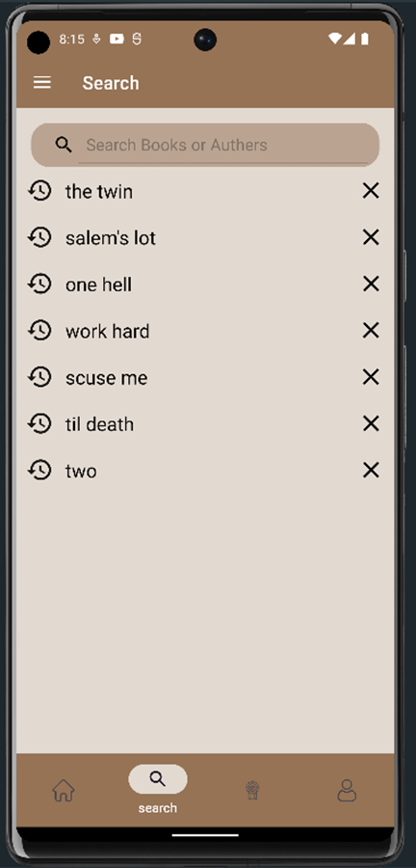
Mobile Application
Search for books page where users can search for books and show his history

Slide 38
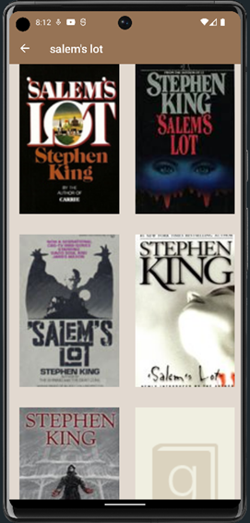
Mobile Application
The search results page where books matching the search query are shown in a list of books

Slide 39
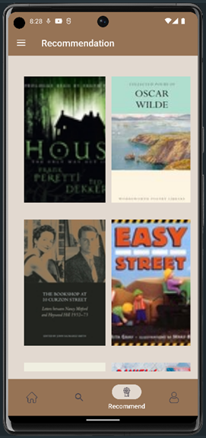
Mobile Application
Recommendation page where users can view all recommendation books based on his favourite books

Slide 40
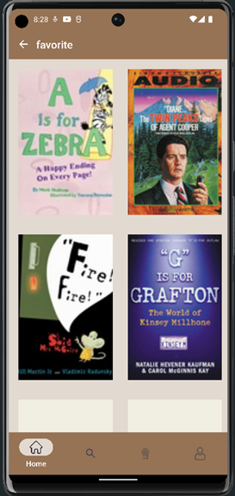
Mobile Application
Favourite page where users can view all favourite books

Slide 41
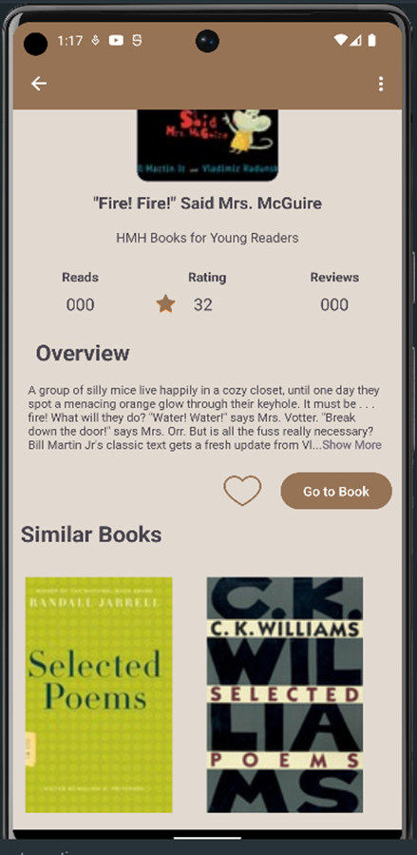
Mobile Application
Book page where users can view all Book Details

Slide 42
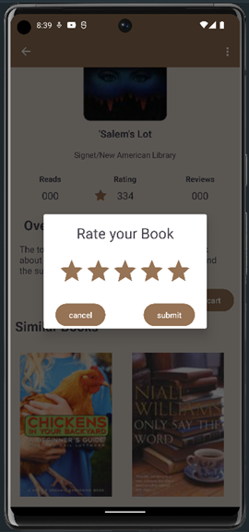
Mobile Application
Rate page where users can rate our favorite book

Slide 43
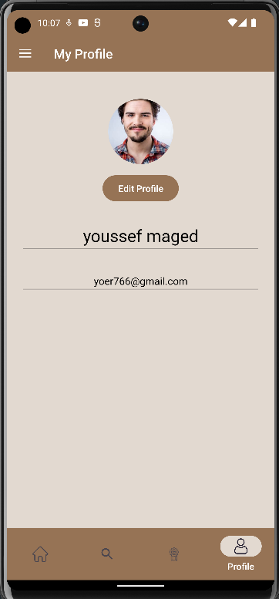
Mobile Application
User’s Profile page where users can view his profile and can pick image from gallery and camera

Slide 44
Data Collections
Data collection documents the structure, attributes, and data types of the collections or documents within the database. It provides a comprehensive reference guide for understanding the data stored in the MongoDB database,

Slide 45
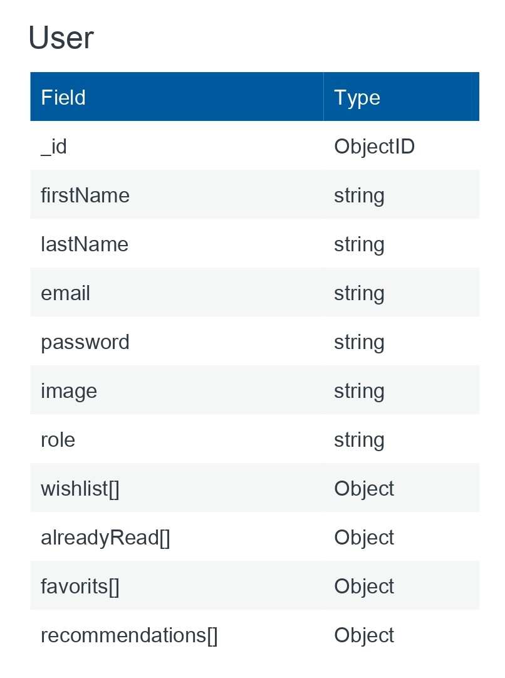
Data Collections
Users Schema

Slide 46
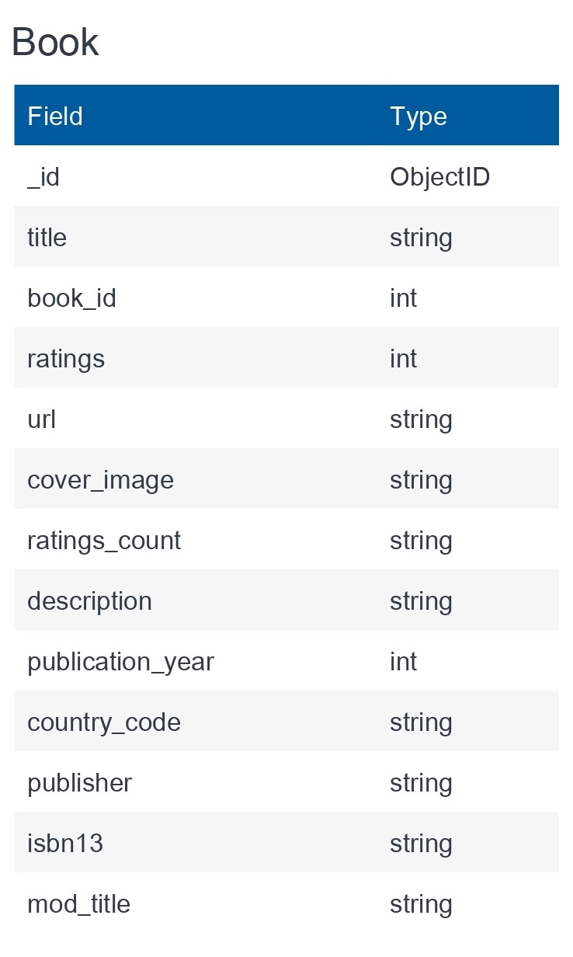
Data Collections
Books Schema

Slide 47


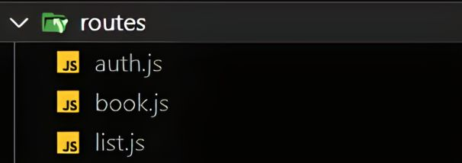
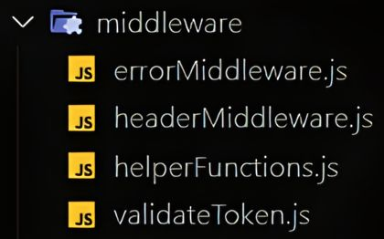
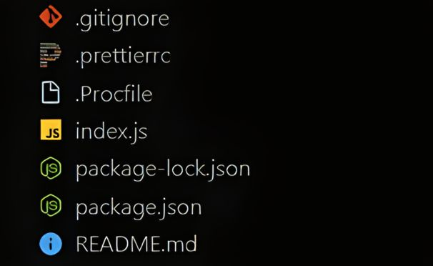
Project Structure

Slide 48
6
Testing

Slide 49
Functional Requirements Testing
Functional Requirement Number | Test Case No. | Functional Requirement Description
R1 | T1 | Receiving confirmation email.
R2 | T2 | Login to the application.
R3 | T3 | User can view all books.

Slide 50
Functional Requirements Testing
Functional Requirement Number | Test Case No. | Functional Requirement Description
R4 | T4 | User can interact with book.
R5 | T5 | User can buy book
R6 | T6 | User can search for a book

Slide 51
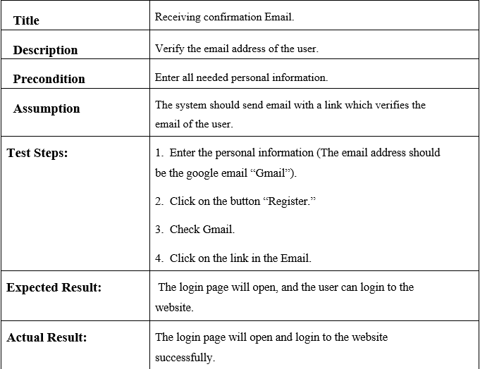
Test Case:1

Slide 52
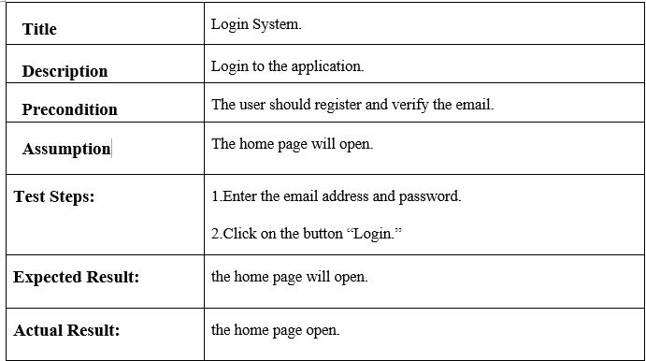
Test case:2

Slide 53
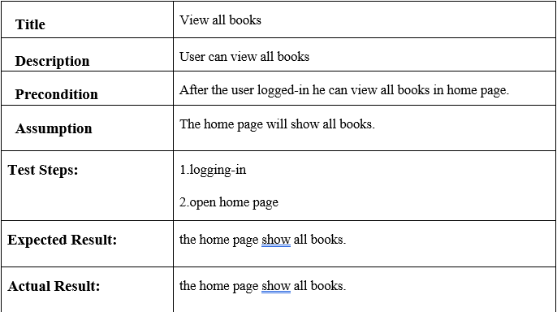
Test Case : 3

Slide 54
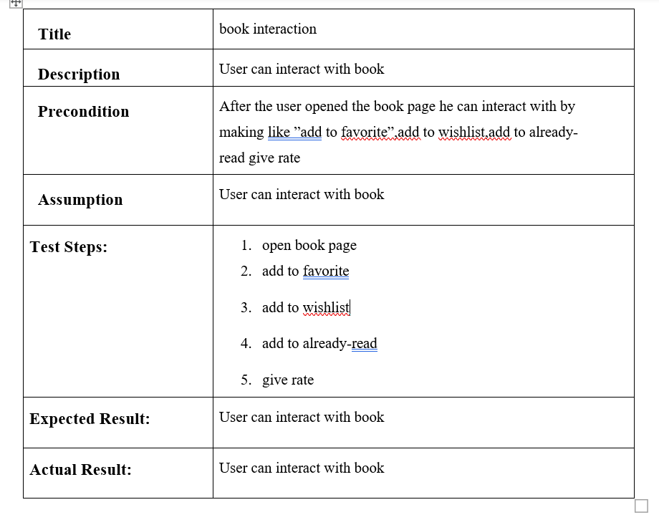
Test Case : 4

Slide 55
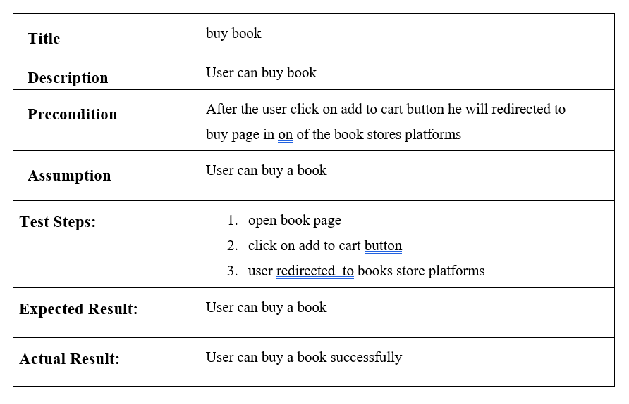
Test Case : 5

Slide 56
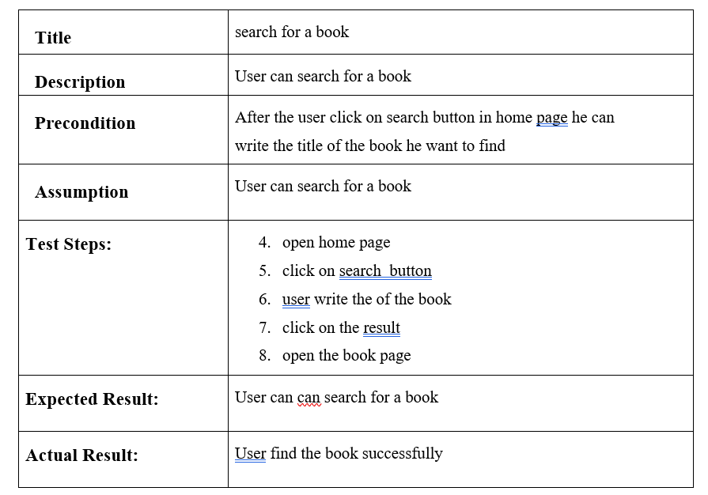
Test Case : 6

Slide 57
7
Security

Slide 58
Overview Of Application Security
Definition of application security
Importance of application security
Common security threats to applications

Slide 59
Best Practices For Application Security
Complex Password
Secure coding practices
Authentication and authorization
Encryption and decryption

Slide 60
CIA Triad
confidentiality
Integrity
Availability

Slide 61
8
Conclusion and Future work

Slide 62
Conclusion
The Android app provides personalized book recommendations using collaborative filtering models, utilizing Node.js, Express.js, MongoDB, and Mongoose as backend technologies. The app uses Node.js for fast server development, Express.js for Rest APIs, and MongoDB for efficient book data management. The app's user-based and item-based filtering models analyze similar user preferences, generating recommendations for specific users. The app's responsive and intuitive user interface enhances user experience.

Slide 63
Future Works
Upgrade to premium web hosting for better performance and reliability. Upgrade MongoDB cluster for robust configuration. Implement content-based recommendation model for enhanced recommendations. Expand book collection for a broader selection. Create an admin dashboard using React, author signup/in webpage, author form for book uploads, and comments section for book reviews, ratings, and comments.
Message #general
Upgrade to premium web hosting for better performance and reliability.
Upgrade MongoDB cluster for robust configuration.
Implement content-based recommendation model for enhanced recommendations.
Expand book collection for a broader selection.
Create an admin dashboard using React, author sign up/in webpage, author form for book uploads, comments section for book reviews, ratings.

Slide 64
THANKS!

